Slide 1

Programarea aplicatiilor de simulare

Slide 2
Mars Invaders
Top-down shooter
Made with Unity Engine

Slide 3
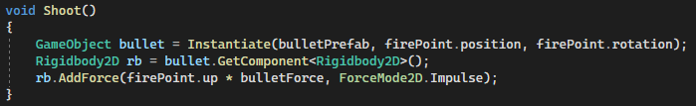
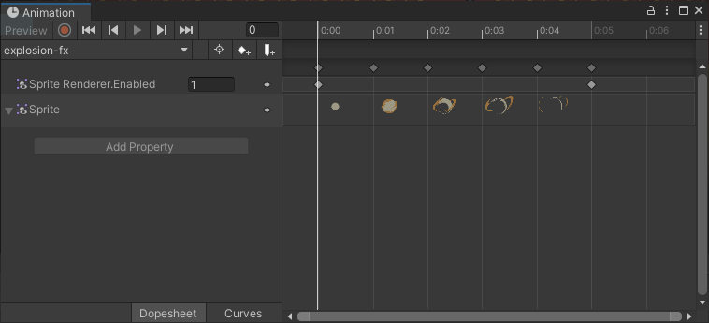
Phyisics and Animation
We use physics while firing the gun by adding force to it, and on collision we start the explosion animation.

Slide 4
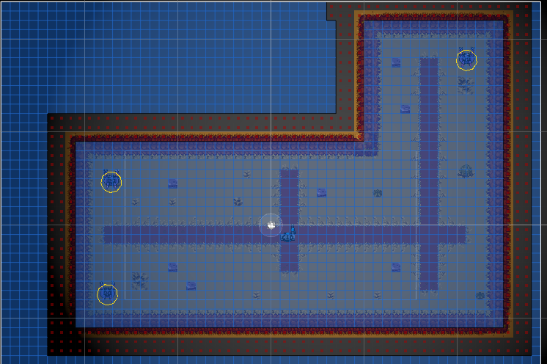
Artificial Intelligence
Enemies are using A* Pathfinding algorithm in order to attack the player.

Slide 5
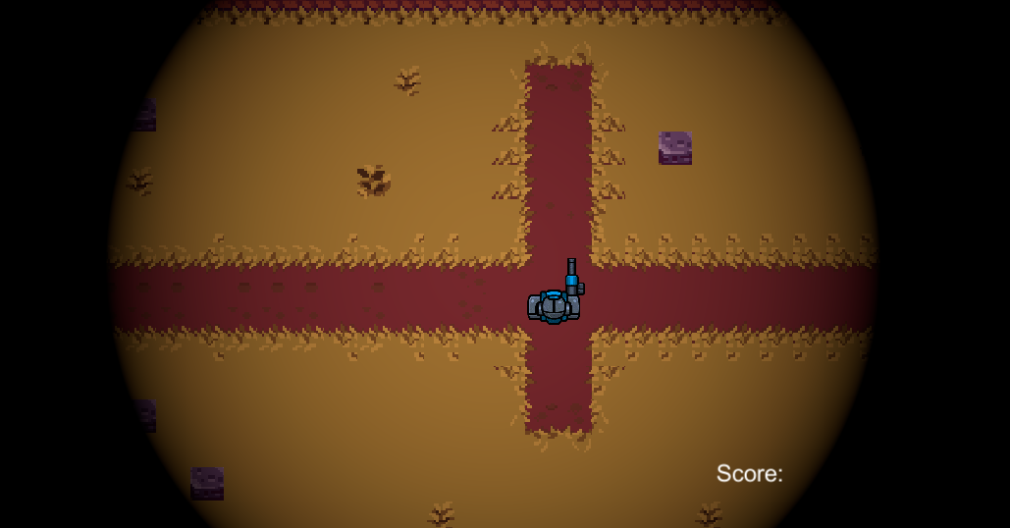
Post Processing and UI
We are using the Vintage effect on the camera in order to limit the player visibility.
We display the player’s score on a canvas.

